Slide 1
Caerphilly North
Neighbourhood Policing Team
Monthly Police Inspector Surgery
Bargoed Wards
June 26’
Notes:
Subtitle – Arial: Bold. Sentence case. 24 Pt.
Main text – Arial: Reg. Sentence case. 20 Pt.
Bullet Points – Arial: Reg. Sentence case. 20 Pt. Line Spacing 1.5.
Bold where appropriate.
Alternate slide formats between Left & Right.
Do not:
Change text colour.
Enlarge text size.
Move content over background images.

Slide 2
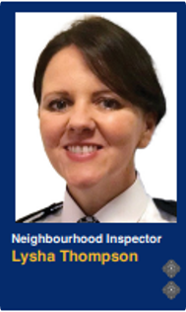
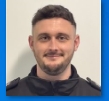
Welcome
Inspector
Lysha Thompson
Ps 1555
Thomas Brookes

Slide 3
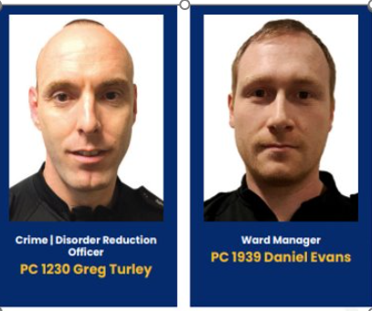
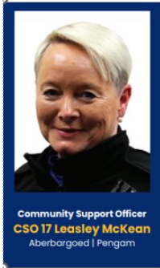
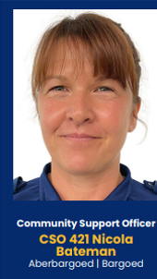
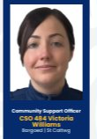
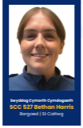

Bargoed Neighbourhood Team
Additional Ward Manager
PC 1888 Leah Durham – Aberbargoed and Pengam
PCSO Victoria Williams
Maternity Leave
1 New PCSO started 8 - week tutorship period this week.
Welcome to PCSO 566 Llewis Healan

Slide 4
Crime & ASB Overview
Crime | May 26' | June 26'
Bargoed | 69 | 45
St Cattwg | 53 | 48
Aberbargoed | 32 | 32
Pengam | 12 | 24
Gilfach | 19 | 12
Total | 185 | 161
Crime & ASB patterns to note (Final May figures now added)
Pengam Ward has experienced a spate of overnight vehicle crime.
An attempted burglary at Meadow Close on the 15th June
No known suspect at this time.
Team are continuing with target hardening messaging.
Incidents of note
Car fire at side of Police station
Serious RTC Gelligaer Common (arrest x 2) with RPSO
House / Garden fire at Heol Y Waun, Gelligaer
Att. theft of Range Rover at St Gladwys Avenue
Prolific shoplifter from Gelligaer Shopping
Centre located and arrested.
ASB (Nuisance) | May 26' | June 26'
Aberbargoed | 1 | 4
St Cattwg | 9 | 3
Bargoed | 11 | 11
Gilfach | 0 | 4
Pengam | 5 | 0
Total | 26 | 22
Following the spike last month calls to the Retail Park and Town Centre calls have reduced.

Slide 5
Targeted Activity updates
Increased focus last couple of weeks for Road Safety – increasing concerns noted at our surgeries.
01.06.26 Further seizure of a Suron Bike having been driven through Bargoed Town Centre – followed on foot by officers and seized, rider reported.
Officers have been conducted the 3 in 1 checks for Go Safe at identified locations in Bargoed.
10.06.26 Further Op Atal planned in Ystrad Mynach – Ward Managers were abstracted to cover another workstream team. No Op Atal data to report this month.
16.06.26 - Following PWITS conviction by our Community Action Team our CADRO and CCBC Housing working in collaboration secured a Tenant Eviction at Court for an occupant at Heol Cae Derwen, Bargoed.
18.06.26 – Misuse Of Drugs Warrant executed in Bargoed – number of warrants under development, positive community intelligence.
Additional 2 warrants sworn out this week for execution.
Will provide further updates next meeting.
Male subject x 2 wanted for Prison Recall – located by Ward Managers and arrested.
Both now returned to Prison.

Slide 6
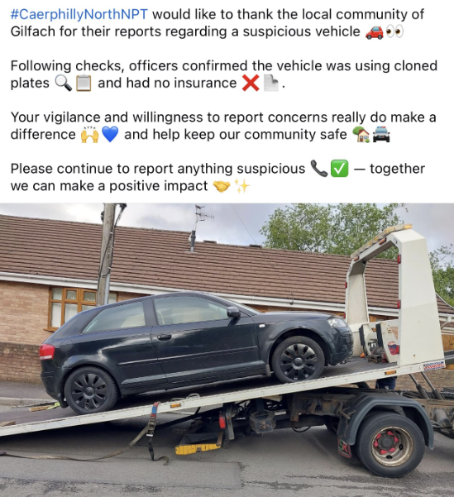
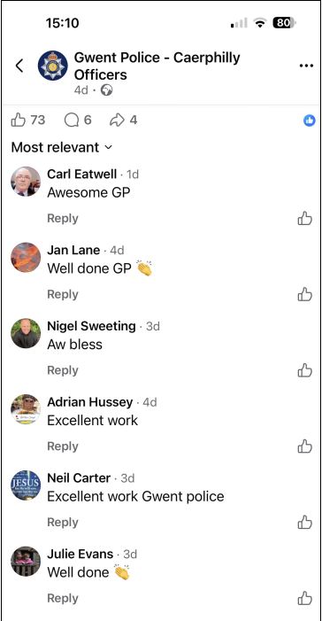

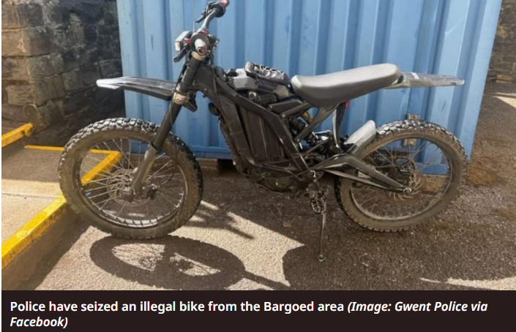
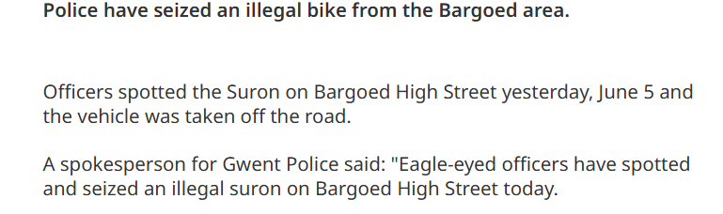
Targeted Activity – In action

Slide 7
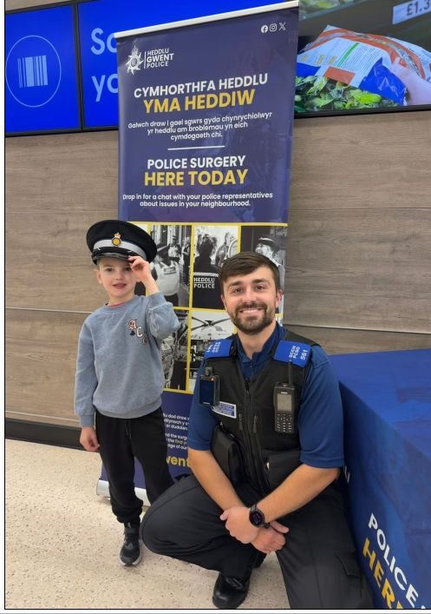
Engaging Communities - Overview
Team have continued to both facilitate and attend a number of community events across Caerphilly North.
Recorded 45 events on the Engagement Calendar over the past 3 weeks including
10 Police Surgeries
6 Council Meetings
7 Crime Prevention Events
17 Community engagement events
Of the 17 engagement events, this has included
Bike Marking Security Events
“Cuppa with a PCSO”
“knit and Natter” Groups
Over 55 Coffee Morning support groups
The Toy Box Project
Carers Week supporting events
Multi Agency Workshops
“Walk & Talk” with Councillors and Housing Officers
“Walk & Talk” with the PCC
Meet Connor – regular attendee at our surgeries and events.

Slide 8
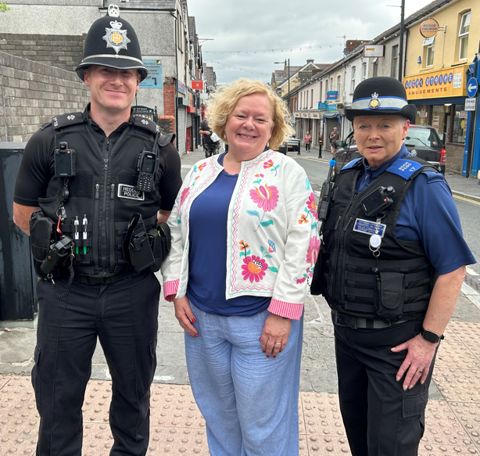
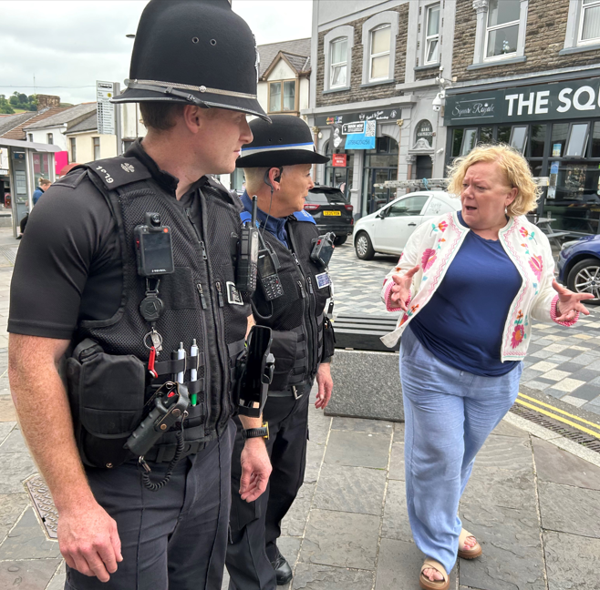
Engaging Communities
Walk & Talk with PCC at Bargoed Town centre
18.06.26
Male person located during the patrols in possession of Cannabis.
Stop / Search
Drugs seized
Community Resolution issued at scene.

Slide 9
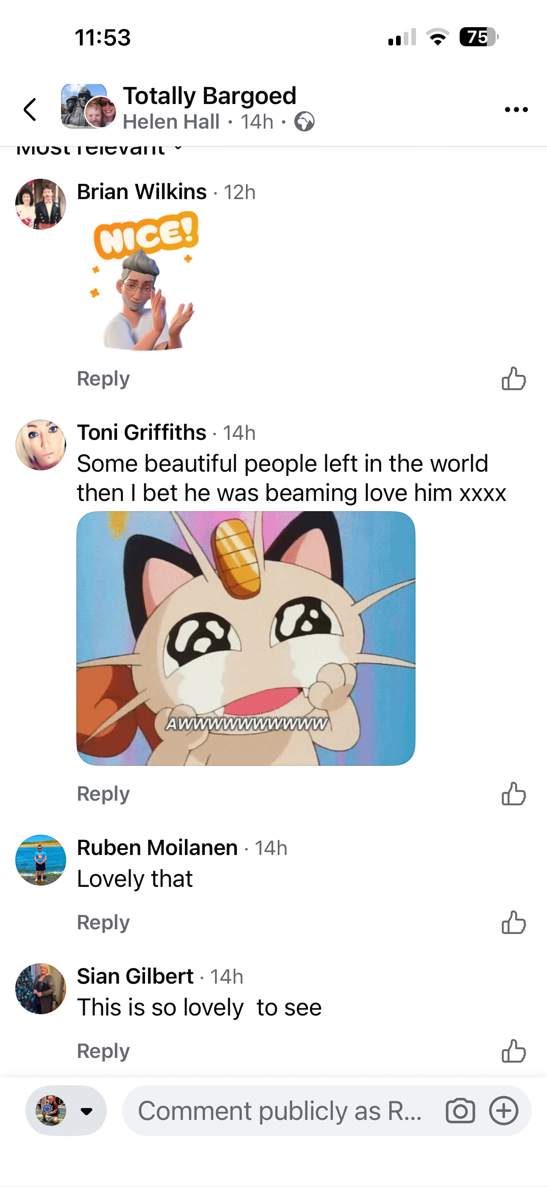

Engaging Communities – Little things Big Impact

Slide 10
Matters raised
Bargoed & Gilfach | Nil Raised
Aberbargoed | Nil Raised
St Cattwg | Nil raised
Pengam | Ward Manager dealing with ongoing n'hood dsiputes | Updates discussed.

